Slide 1
Online Learning Platform using MERN
TEAM MEMBERS:
GURU VARSHENI A
S DHANUSHREE
R AMAYA
V M MEGA

Slide 2
ABSTRACT
The rapid growth in digital education demands a flexible, scalable, and user-friendly platform to support diverse learning needs. Online learning platform built with the MERN stack (MongoDB, Express.js, React, and Node.js), providing an innovative solution for online education. The platform is designed to serve both students and instructors by facilitating course creation, enrollment, progress tracking, and real-time communication. MongoDB, as the platform's database, efficiently manages and scales data, including user profiles, course materials, and assessment records. Express.js and Node.js provide a robust backend framework to handle API requests, user authentication, and secure data interactions. React powers the frontend, delivering a dynamic, responsive, and interactive user experience. The unified JavaScript environment of the MERN stack enables streamlined development and easier maintenance. Key features of the platform include course creation and management, video streaming, assignment submission, quizzes, discussion forums, and notifications. The design prioritizes user experience, with intuitive navigation for students and comprehensive control options for educators. Additionally, real-time updates enable effective communication, enhancing the collaborative learning experience .

Slide 3
INTRODUCTION
The rise of digital technology has transformed education, enabling students and instructors worldwide to access learning materials, collaborate, and engage in academic pursuits online. With this shift, there is a growing demand for online learning platforms that are scalable, responsive, and user-friendly, offering both flexibility and accessibility. The MERN stack—comprising MongoDB, Express.js, React, and Node.js presents a powerful framework for building such platforms, providing an end-to-end JavaScript-based solution for rapid, efficient, and scalable development. An online learning platform using the MERN stack offers seamless integration of frontend and backend capabilities, making it particularly suitable for handling dynamic content, real-time updates, and complex user interactions. MongoDB, a NoSQL database, provides a flexible and highly scalable data structure ideal for handling unstructured data, such as multimedia files, student progress records, and course content. Express.js and Node.js support a robust server environment that facilitates efficient request handling, secure user authentication, and smooth interactions between the client and server. React, as the frontend framework, enables the development of a dynamic and responsive user interface, enhancing the overall user experience for students and educators alike.

Slide 4
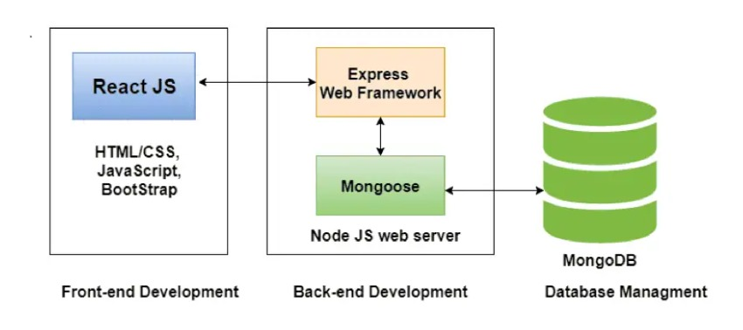
ARCHITECTURE DIAGRAM

Slide 5
PROPOSED SYSTEM
An online learning platform(OLP) is a digital platform that provides a variety of tools and resources to facilitate learning and education over the internet. Here are some key features and a description of an online learning platform:
User-Friendly Interface: Online learning platforms typically have an intuitive and user-friendly interface that makes it easy for learners, regardless of their technical proficiency, to navigate and access the content.
Course Management: Instructors or course creators can upload, organize, and manage course materials. Learners can enroll in courses and track their progress.
Interactivity: Many platforms include interactive elements like discussion forums, chat rooms, and live webinars, which foster communication and collaboration among learners and instructors.
Accessibility: Content is often accessible on various devices, including computers, tablets, and smartphones, making learning possible from anywhere with an internet connection.
Self-Paced Learning: Learners can typically access course materials at their own pace. This flexibility allows for learning that fits into individual schedules and preferences.
Payment and Subscription Options: There may be free courses, but some content may require payment or a subscription. Platforms often offer multiple pricing models.

Slide 6
FRONTEND
The Front-end of the Online Learning Platform is developed using React. React is a versatile JavaScript library developed by Facebook that has revolutionized the way web applications are built. It's particularly well-suited for creating dynamic and interactive user interfaces. React has the one feature called Component Based Architecture, that breaks down the complex UI design into smaller, reusable components.
React has its own library and tools like Redux, Router, Testing Library etc. Using these features user can easily navigate to the particular courses and they can select the courses that they want to learn.
Use Cases for React in Online Learning Platforms:
Interactive Course Content like Video Players, Quizzes and Assessment.
Personalized Learning Experiences, Adaptive Learning.
React offers a multitude of benefits for building robust and engaging online learning platforms. Here are some key advantages like Component-Based Architecture, Declarative Programming, Cross-Platform Development, Third-Party Libraries, Developer Productivity. A powerful feature introduced in React 16.8 that allows you to use state and other React features in functional components. By leveraging React's power and flexibility, you can build online learning platforms that are both performant and user-friendly, providing an exceptional learning experience.

Slide 7
BACKEND
The Backend of the Online Learning Platform is built using MongoDB, Express.js, Node.js that provides a user-friendly ecosystem for the online learners.
MongoDB: is a popular NoSQL database that uses a flexible schema to store data in JSON-like documents. Document Model is main Data is stored in flexible JSON-like documents. MongoDB is an excellent choice for online learning platforms due to its flexibility, scalability, and high performance.
Express.js: is a minimalist and flexible Node.js web application framework that can be used to build robust and scalable online learning platforms.
Node.js: a powerful JavaScript runtime environment, is a cornerstone for building scalable and efficient online learning platforms. Creating a RESTful APIs to expose functionalities like user authentication, course enrollment, and content delivery. Enable real-time collaboration between learners and instructors.
By leveraging MongoDB's capabilities, you can build robust, scalable, and personalized online learning platforms that deliver exceptional user experiences.

Slide 8
INTEGRATION
The Online Complaint Registration and Management System integrates the React frontend with the Express, Node.js, and MongoDB backend through seamless communication enabled by APIs. A well-integrated frontend and backend is crucial for a seamless online learning experience.
Frontend (Client-Side):User Interface:Displays course content, quizzes, assignments, and other learning materials. Provides interactive elements like progress bars, video players.
Backend (Server-Side):Stores user information, course content, learning progress, and other relevant data. Implements the core logic of the platform, such as course enrollment, payment processing, and certificate generation.
Database: Data is transferred between the frontend and backend in a structured format, such as JSON. The frontend parses the received data and updates the UI accordingly.
By effectively integrating the frontend and backend, you can create a robust, scalable, and user-friendly online learning platform that delivers a seamless learning experience.

Slide 9
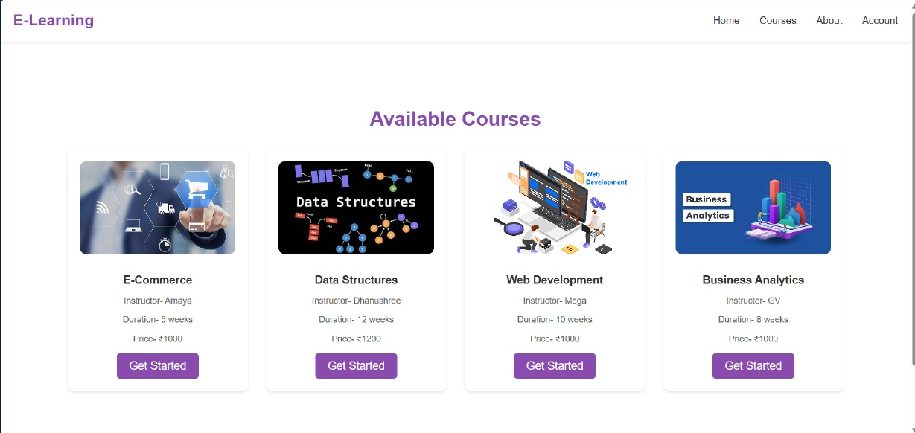
MODEL

Slide 10
CONCLUSION
The developed online learning system offers a robust and flexible platform for delivering high-quality educational content. Using Technolohies such as React, Node.js, MongoDB, the system provides an engaging and interactive learning experience.
Benefits of Online Learning:
Self-Paced Learning: Learn at your own pace and schedule.
Wide Range of Courses: Access a vast array of courses from various institutions and providers
Global Learning: Connect with learners from around the world.
This online learning system empowers learners by providing access to quality education anytime, anywhere. By leveraging the power of technology, online learning empowers individuals to achieve their educational and career goals.

